Slide 1
Correlation and Causation
Notes:
https://docs.google.com/spreadsheets/d/1IwgftHmcPGa8ZVsklt6-K-ep4C7VezHZ3yhhqe6f3GA/edit#gid=1767382413

Slide 2
Correlation and Causation
If 2 variables X and Y are correlated, can we expect to see a change in Y if we change variable X? Not necessarily! Variable Y would change only if a causal relationship exists between X and Y Let’s see some examples on the following slides

Slide 3
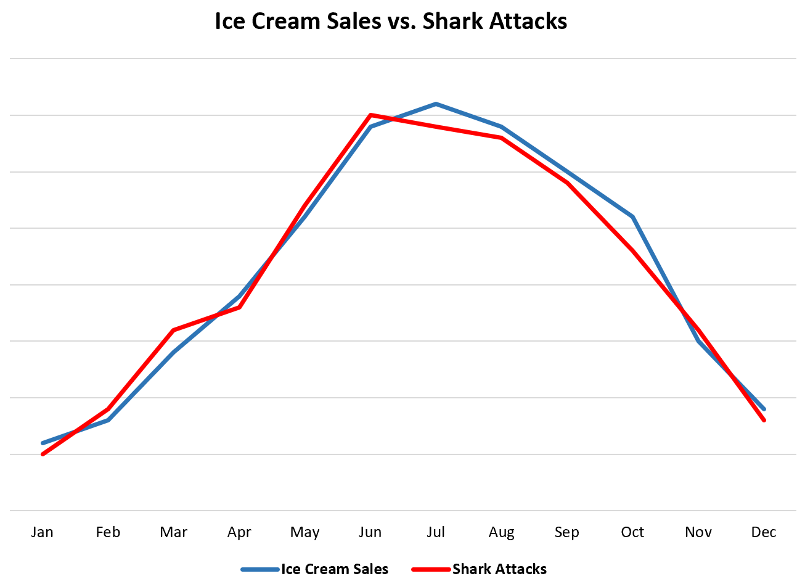
Correlation and Causation
The adjacent graph shows ice cream sales being heavily correlated with shark attacks. Does consuming ice cream make it more likely for one to be consumed by sharks? No! The more likely explanation is that in warmer weather, people are more likely to consume ice cream and go into the ocean

Slide 4
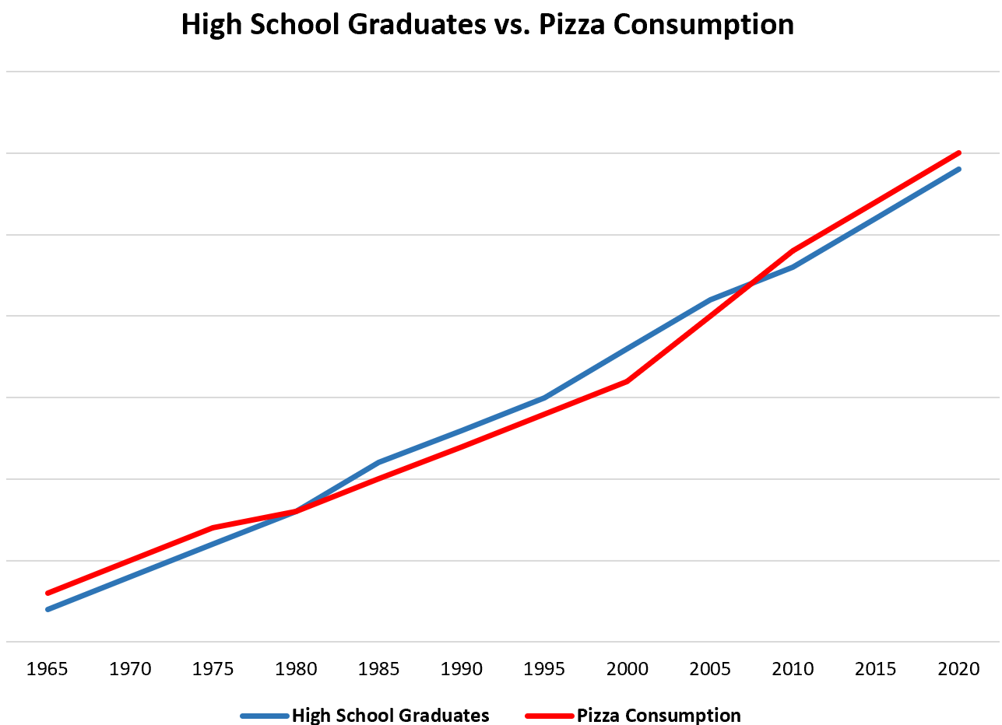
Correlation and Causation
The adjacent graph shows the number of high school graduates being correlated with increased pizza consumption.
Is graduating high school causing more people to eat pizza?
The more likely explanation is that as population increases, there are increases in both pizza sales as well as the number of high school graduates

Slide 5
Correlation and Causation
When analyzing two correlated variables, it’s important to look for the presence of other variables that might influence both correlated variables (that is, a confounding variable) Correlation does not always mean causation.

